Slide 1

Inference: entailment
Entailment: α |= β (“α entails β” or “β follows from α”) iff in every world where α is true, β is also true
I.e., the α-worlds are a subset of the β-worlds [models(α) ⊆ models(β)]
In the example, α₂ |= α₁
(Say α₂ is ¬Q ∧ R ∧ S ∧ W
α₁ is ¬Q )
α₁
α₂

Slide 2
Inference: proofs
A proof is a demonstration of entailment between α and β
Sound algorithm: everything it claims to prove is in fact entailed
Complete algorithm: every that is entailed can be proved

Slide 3
Inference: proofs
Method 1: model-checking
For every possible world, if α is true make sure that is β true too
OK for propositional logic (finitely many worlds); not easy for first-order logic
Method 2: theorem-proving
Search for a sequence of proof steps (applications of inference rules) leading from α to β
E.g., from P and (P ⇒ Q), infer Q by Modus Ponens

Slide 4
Propositional logic syntax
Given: a set of proposition symbols {X₁,X₂,…, X_{n}}
(we often add True and False for convenience)
X_{i} is a sentence
If α is a sentence then ¬α is a sentence
If α and β are sentences then α ∧ β is a sentence
If α and β are sentences then α ∨ β is a sentence
If α and β are sentences then α ⇒ β is a sentence
If α and β are sentences then α ⇔ β is a sentence
And p.s. there are no other sentences!

Slide 5
Propositional logic semantics
Let m be a model assigning true or false to {X₁,X₂,…, X_{n}}
If α is a symbol then its truth value is given in m
¬α is true in m iff α is false in m
α ∧ β is true in m iff α is true in m and β is true in m
α ∨ β is true in m iff α is true in m or β is true in m
α ⇒ β is true in m iff α is false in m or β is true in m
α ⇔ β is true in m iff α ⇒ β is true in m and β ⇒ α is true in m

Slide 6
Example
Let m be {A=true, B=true, C=false, D=false}
Let α be the sentence (A ∧ B) ∨ (C ∧ ¬D)
α is true in m iff (A ∧ B) is true in m or (C ∧ ¬D) is true in m
(A ∧ B) is true in m iff A is true in m and B is true in m
(A ∧ B) is true in m
α is true in m

Slide 7
Example
Let α be the sentence (A ∧ B) ∨ (C ∧ ¬D)
In how many models is α true?

Slide 8
The plan
Tell the logical agent what we know about PacPhysics
Ask it what actions have to be true for the goal to be achieved

Slide 9
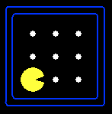
Partially observable Pacman
Pacman knows the map but perceives just wall/gap to NSEW
Formulation: what variables do we need?
Wall locations
Wall_0,0 there is a wall at [0,0]
Wall_0,1 there is a wall at [0,1], etc. (N symbols for N locations)
Percepts
Blocked_W (blocked by wall to my West) etc.
Blocked_W_0 (blocked by wall to my West at time 0) etc. (4T symbols for T time steps)
Actions
W_0 (Pacman moves West at time 0), E_0 etc. (4T symbols)
Pacman’s location
At_0,0_0 (Pacman is at [0,0] at time 0), At_0,1_0 etc. (NT symbols)

Slide 10


How many possible worlds?
N locations, T time steps => N + 4T + 4T + NT = O(NT) variables
O(2^{NT}) possible worlds!
N=200, T=400 => ~10²⁴⁰⁰⁰ worlds
Each world is a complete “history”
But most of them are pretty weird!

Slide 11
Pacman’s knowledge base: Map
Pacman knows where the walls are:
Wall_0,0 ∧ Wall_0,1 ∧ Wall_0,2 ∧ Wall_0,3 ∧ Wall_0,4 ∧ Wall_1,4 ∧ …
Pacman knows where the walls aren’t!
¬Wall_1,1 ∧ ¬Wall_1,2 ∧ ¬Wall_1,3 ∧ ¬Wall_2,1 ∧ ¬Wall_2,2 ∧ …

Slide 12
Pacman’s knowledge base: Initial state
Pacman doesn’t know where he is
But he knows he’s somewhere!
At_1,1_0 ∨ At_1,2_0 ∨ At_1,3_0 ∨ At_2,1_0 ∨ …
And he knows he’s not in more than one place!
¬ (At_1,1_0 ∧ At_1,2_0) ∧ ¬ (At_1,1_0 ∧ At_1,3_0) …

Slide 13
Pacman’s knowledge base: Sensor model
State facts about how Pacman’s percepts arise…
<Percept variable at t> ⇔ <some condition on world at t>
Pacman perceives a wall to the West at time t if and only if he is in x,y and there is a wall at x-1,y
Blocked_W_0 ⇔ ((At_1,1_0 ∧ Wall_0,1) v
(At_1,2_0 ∧ Wall_0,2) v
(At_1,3_0 ∧ Wall_0,3) v …. )
4T sentences, each of size O(N)
Note: these are valid for any map

Slide 14
Pacman’s knowledge base: Transition model
How does each state variable at each time gets its value?
Here we care about location variables, e.g., At_3,3_17
A state variable X gets its value according to a successor-state axiom
X_t ⇔ [X_t-1 ∧ ¬(some action_t-1 made it false)] v
[¬X_t-1 ∧ (some action_t-1 made it true)]
For Pacman location:
At_3,3_17 ⇔ [At_3,3_16 ∧ ¬((¬Wall_3,4 ∧ N_16) v (¬Wall_4,3 ∧ E_16) v …)]
v [¬At_3,3_16 ∧ ((At_3,2_16 ∧ ¬Wall_3,3 ∧ N_16) v
(At_2,3_16 ∧ ¬Wall_3,3 ∧ N_16) v …)]

Slide 15
How many sentences?
Vast majority of KB occupied by O(NT) transition model sentences
Each about 10 lines of text
N=200, T=400 => ~800,000 lines of text, or 20,000 pages
This is because propositional logic has limited expressive power
Are we really going to write 20,000 pages of logic sentences???
No, but your code will generate all those sentences!
(In first-order logic, we need O(1) transition model sentences)
(State-space search uses atomic states: how do we keep the transition model representation small???)

Slide 16
Some reasoning tasks
Localization with a map and local sensing:
Given an initial KB, plus a sequence of percepts and actions, where am I?
Mapping with a location sensor:
Given an initial KB, plus a sequence of percepts and actions, what is the map?
Simultaneous localization and mapping:
Given …, where am I and what is the map?
Planning:
Given …, what action sequence is guaranteed to reach the goal?
ALL OF THESE USE THE SAME KB AND THE SAME ALGORITHM!!

Slide 17
Summary
One possible agent architecture: knowledge + inference
Logics provide a formal way to encode knowledge
A logic is defined by: syntax, set of possible worlds, truth condition
A simple KB for Pacman covers the initial state, sensor model, and transition model
Logical inference computes entailment relations among sentences, enabling a wide range of tasks to be solved

Slide 18



CS 188: Artificial Intelligence
Inference in Propositional Logic
Instructors: Stuart Russell and Dawn Song
University of California, Berkeley
Notes:
Please retain proper attribution and the reference to ai.berkeley.edu. Thanks!

Slide 19
Inference (reminder)
Method 1: model-checking
For every possible world, if α is true make sure that is β true too
Method 2: theorem-proving
Search for a sequence of proof steps (applications of inference rules) leading from α to β
Sound algorithm: everything it claims to prove is in fact entailed
Complete algorithm: every that is entailed can be proved

Slide 20
Satisfiability and entailment
A sentence is satisfiable if it is true in at least one world
Suppose we have a hyper-efficient SAT solver (WARNING: NP-COMPLETE 👿 👿 👿); how can we use it to test entailment?
α |= β
iff α ⇒ β is true in all worlds
iff ¬(α ⇒ β) is false in all worlds
iff α ∧ ¬β is false in all worlds, i.e., unsatisfiable
So, add the negated conclusion to what you know, test for (un)satisfiability; also known as reductio ad absurdum
Efficient SAT solvers operate on conjunctive normal form

Slide 21
Conjunctive normal form (CNF)
Replace biconditional by two implications
Every sentence can be expressed as a conjunction of clauses
Each clause is a disjunction of literals
Each literal is a symbol or a negated symbol
Conversion to CNF by a sequence of standard transformations:
A ⇒ (W ⇔ B)
A ⇒ ((W ⇒ B) ∧ (B ⇒ W))
¬A v ((¬W v B) ∧ (¬B v W))
(¬A v ¬W v B) ∧ (¬A v ¬B v W)
Replace α ⇒ β by ¬α v β
Distribute v over ∧

Slide 22
Efficient SAT solvers
DPLL (Davis-Putnam-Logemann-Loveland) is the core of modern solvers
Recursive depth-first enumeration of models with some extras:
Early termination: stop if
all clauses are satisfied; e.g., (A ∨ B) ∧ (A ∨ ¬C) is satisfied by {A=true}
any clause is falsified; e.g., (A ∨ B) ∧ (A ∨ ¬C) is falsified by {A=false,B=false}
Pure literals: if all occurrences of a symbol in as-yet-unsatisfied clauses have the same sign, then give the symbol that value
E.g., A is pure and positive in (A ∨ B) ∧ (A ∨ ¬C) ∧ (C ∨ ¬B) so set it to true
Unit clauses: if a clause is left with a single literal, set symbol to satisfy clause
E.g., if A=false, (A ∨ B) ∧ (A ∨ ¬C) becomes (false ∨ B) ∧ (false ∨ ¬C), i.e. (B) ∧ (¬C)
Satisfying the unit clauses often leads to further propagation, new unit clauses, etc.

Slide 23
DPLL algorithm
function DPLL(clauses,symbols,model) returns true or false
if every clause in clauses is true in model then return true if some clause in clauses is false in model then return false P,value ←FIND-PURE-SYMBOL(symbols,clauses,model) if P is non-null then return DPLL(clauses, symbols–P, model∪{P=value})
P,value ←FIND-UNIT-CLAUSE(clauses,model) if P is non-null then return DPLL(clauses, symbols–P, model∪{P=value})
P ← First(symbols); rest ← Rest(symbols) return or(DPLL(clauses,rest,model∪{P=true}),
DPLL(clauses,rest,model∪{P=false}))

Slide 24
Efficiency
Naïve implementation of DPLL: solve ~100 variables
Extras:
Smart variable and value ordering
Divide and conquer
Caching unsolvable subcases as extra clauses to avoid redoing them
Cool indexing and incremental recomputation tricks so that every step of the DPLL algorithm is efficient (typically O(1))
Index of clauses in which each variable appears +ve/-ve
Keep track number of satisfied clauses, update when variables assigned
Keep track of number of remaining literals in each clause
Real implementation of DPLL: solve ~100000000 variables

Slide 25
SAT solvers in practice
Circuit verification: does this VLSI circuit compute the right answer?
Software verification: does this program compute the right answer?
Software synthesis: what program computes the right answer?
Protocol verification: can this security protocol be broken?
Protocol synthesis: what protocol is secure for this task?
Lots of combinatorial problems: what is the solution?
Planning: how can I eat all the dots???

Slide 26
Planning as satisfiability
Given a hyper-efficient SAT solver, can we use it to make plans?
Yes, for fully observable, deterministic case:
planning problem is solvable iff there is some satisfying assignment
solution obtained from truth values of action variables
For T = 1 to ∞,
Initialize the KB with PacPhysics for T time steps
Assert goal is true at time T
Read off action variables from SAT-solver solution

Slide 27
Basic PacPhysics for Planning
Map: where the walls are and aren’t, where the food is and isn’t
Initial state: Pacman start location (exactly one place), ghosts
Actions: Pacman does exactly one action at each step
Transition model:
<at x,y_t> ⇔ [at x,y_t-1 and stayed put] v [next to x,y_t-1 and moved to x,y]
<food x,y_t> ⇔ [food x,y_t-1 and not eaten]
<ghost_{B} x,y_t> ⇔ […..]

Slide 28
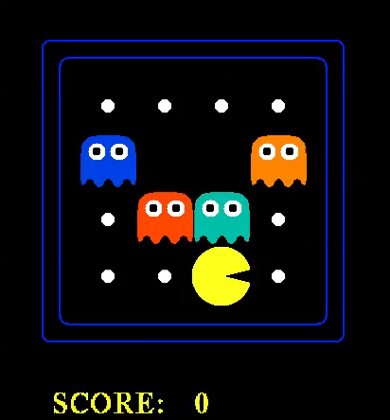

Slide 29
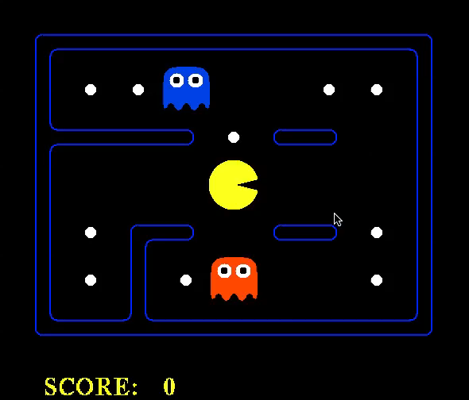

Slide 30
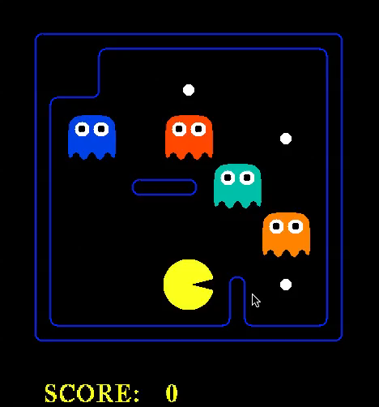

Slide 31
Reminder: Partially observable Pacman
Perceives wall/no-wall in each direction at each time
Variables: Blocked_W_0, Blocked_N_0, …, Blocked_W_1, …
Basic question: where am I?

Slide 32
State estimation
State estimation means keeping track of what’s true now, given a history of observations and actions
A logical agent can just ask itself!
E.g., ask whether KB ∧ <actions> ∧ <percepts> |= At_2,2_6
This is “lazy”: it analyzes one’s whole life history at each step!
A more “eager” form of state estimation:
After each action and percept
For each state variable X_t
If KB ∧ action_t-1 ∧ percept_t |= X_t, add X_t to KB
If KB ∧ action_t-1 ∧ percept_t |= ¬X_t, add ¬X_t to KB

Slide 33
Example: Localization in a known map
Initialize the KB with PacPhysics(+SM) for T time steps
Run the Pacman agent for T time steps:
After each action and percept
For each variable At_x,y_t
If KB ∧ action_t-1 ∧ percept_t |= At_x,y_t, add At_x,y_t to KB
If KB ∧ action_t-1 ∧ percept_t |= ¬ At_x,y_t, add ¬ At_x,y_t to KB
Choose an action
Pacman’s possible locations are those that are not provably false

Slide 34
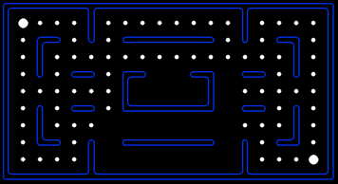

Localization demo
Percept
Action
Percept
Action
Percept
Action
Percept

Slide 35
Localization demo
Percept
Action
Percept
Action
Percept
Action
Percept
SOUTH

Slide 36
Localization demo
Percept
Action
Percept
Action
Percept
Action
Percept
SOUTH
SOUTH

Slide 37
Localization demo
Percept
Action
Percept
Action
Percept
Action
Percept
SOUTH
SOUTH

Slide 38
Localization demo
Percept
Action
Percept
Action
Percept
Action
Percept

Slide 39
Localization demo
Percept
Action
Percept
Action
Percept
Action
Percept
WEST

Slide 40
Localization demo
Percept
Action
Percept
Action
Percept
Action
Percept
WEST

Slide 41
Localization demo
Percept
Action
Percept
Action
Percept
Action
Percept
WEST
WEST

Slide 42
Localization demo
Percept
Action
Percept
Action
Percept
Action
Percept
WEST
WEST

Slide 43
Localization demo
Percept
Action
Percept
Action
Percept
Action
Percept
WEST
WEST
WEST

Slide 44
Localization demo
Percept
Action
Percept
Action
Percept
Action
Percept
WEST
WEST
WEST

Slide 45
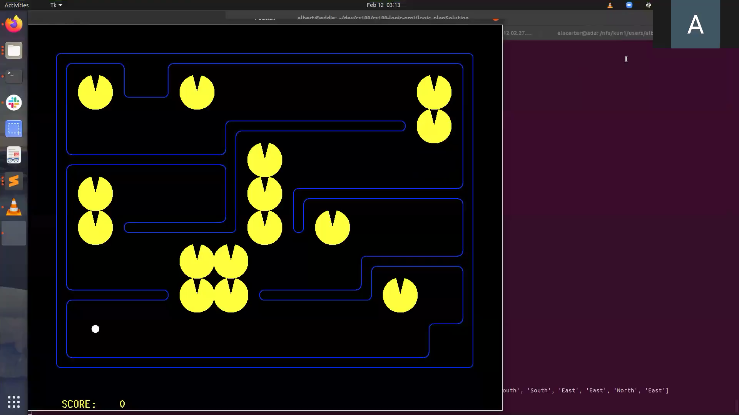
Localization with random movement

Slide 46

State estimation contd.
Is the eager method enough for accurate state estimation?
No! There can be cases where neither X_{t} nor ¬X_{t} is entailed, and neither Y_{t} nor ¬Y_{t} is entailed, but some constraint, e.g., X_{t} v Y_{t}, is entailed
Exact state estimation is intractable in general

Slide 47
Example: Mapping from a known relative location
Without loss of generality, call the initial location 0,0
The percept tells Pacman which actions work, so he always knows where he is
“Dead reckoning”
Initialize the KB with PacPhysics for T time steps, starting at 0,0
Run the Pacman agent for T time steps
At each time step
Update the KB with previous action and new percept facts
For each wall variable Wall_x,y
If Wall_x,y is entailed, add to KB
If ¬Wall_x,y is entailed, add to KB
Choose an action
The wall variables constitute the map

Slide 48
Mapping demo
Percept
Action
Percept
Action
Percept
Action
Percept
NORTH
EAST
SOUTH

Slide 49
Simultaneous localization and mapping
Often, dead reckoning won’t work in the real world
E.g., sensors just count the number of adjacent walls (0,1,2,3 = 2 bits)
Pacman doesn’t know which actions work, so he’s “lost”
So if he doesn’t know where he is, how does he build a map???
Initialize the KB with PacPhysics for T time steps, starting at 0,0
Run the Pacman agent for T time steps
At each time step
Update the KB with previous action and new percept facts
For each x,y, add either Wall_x,y or ¬Wall_x,y to KB, if entailed
For each x,y, add either At_x,y_t or ¬At_x,y_t to KB, if entailed
Choose an action

Slide 50
Simple theorem proving: Forward chaining
Forward chaining applies Modus Ponens to generate new facts:
Given X₁ ∧ X₂ ∧ … X_{n} ⇒ Y and X₁, X₂, …, X_{n}, infer Y
Forward chaining keeps applying this rule, adding new facts, until nothing more can be added
Requires KB to contain only definite clauses:
(Conjunction of symbols) ⇒ symbol; or
A single symbol (note that X is equivalent to True ⇒ X)

Slide 51
Properties of forward chaining
Theorem: FC is sound and complete for definite-clause KBs
Soundness: follows from soundness of Modus Ponens (easy to check)
Completeness: see proof on p. 230-1.
Runs in linear time using two simple indexing tricks:
Each symbol X_{i} knows which rules it appears in
Each rule keeps count of how many of its premises are not yet satisfied
Very commonly used in database (Datalog) systems for updating

Slide 52
Backward chaining (briefly)
Backward chaining works the other way around:
Start from the goal Y to prove
Find implications X₁ ∧ X₂ ∧ … X_{n} ⇒ Y with Y on the right-hand side
Set up X₁, X₂, …, X_{n} as subgoals to prove recursively (stop at known facts)
Theorem: BC is sound and complete for definite-clause KBs
Linear-time with suitable indexing and caching of subgoals
BC with first-order definite clauses is the basis of logic programming

Slide 53
Resolution (briefly)
The resolution inference rule takes two implication sentences (of a particular form) and infers a new implication sentence:
Example: A ∧ B ∧ C ⇒ U ∨ V
D ∧ E ∧ U ⇒ X ∨ Y
A ∧ B ∧ C ∧ D ∧ E ⇒ V ∨ X ∨ Y
Resolution is complete for propositional logic
Exponential time in the worst case

Slide 54
Summary
Logical inference computes entailment relations among sentences
Theorem provers apply inference rules to sentences
Forward chaining applies modus ponens with definite clauses; linear time
Resolution is complete for PL but exponential time in the worst case
SAT solvers based on DPLL provide incredibly efficient inference
Logical agents can do localization, mapping, SLAM, planning (and many other things) just using one generic inference algorithm on one knowledge base

